Slide 1

END-END AI GYM TRAINER
Guided By:
Mr. Purushottam Sharma
Submitted By:
Payal Verma
Krishna Chaudhary

Slide 2
END-END AI GYM TRAINER
By
Payal Verma
KRISHNA CHAUDHARY
Under the guidance of
Mr. PURUSHOTTAM SHARMA
TRAINER, MACHINE LEARNING AND DEEP LEARNING
Department of Data Analytics and Machine Learning
Imarticus Learning

Slide 3
ACKNOWLEDGEMENT
I would like to thank my institute “IMARTICUS LEARNING, NEW DELHI” for giving me this opportunity of doing a project to gain practical experience to enable myself by understanding the demand of professional environment.
I express my deep sense of gratitude to Mr. Purushottam Sharma (Trainer) and all my Trainers guidance, suggestions had been source of my inspiration & were very helpful during my project.
Thank You,
Payal Verma & Krishna Chaudhary

Slide 4
Flow of Agenda
Part-1 Introduction to Project
Part-2 Project-Planning & Requirement
Part-3 Biblo-Graphy

Slide 5
Part-1 Introduction to Project

Slide 6
Introduction
"Health is wealth!" For hundreds of decades, we have known this saying. But only 20-30% of the globe truly has healthy habits and, other than walking, the rest of the 70% have no physical exercise.
Recently lot of people facing many health issues due to the lack of physical activity. Not getting enough physical activity can lead to heart disease, even for people who have no other risk factors. It can also increase the likelihood of developing other heart disease risk factors, including obesity, high blood pressure, high blood cholesterol. This project will help you as trainer at home.
The project aims to keep track of the number of exercise repetition you performed, along with a pose correction feedback mechanism to correct your pose if needed. This will work like a personal gym trainer.

Slide 7
What are AI Gym Trainer?
AI tracks the exercise patterns and health behaviors of the user to offer better approaches towards their fitness goals. ML and AI are integrated into smartwatches and smartphones to provide accurate results for making users healthier and fit. AI revolutionizes fitness through fitness equipment that makes home workouts smarter and better.

Slide 8
How is AI revolutionizing the Fitness Industry?
AI-Based Personal Trainer
Human Pose Estimation Technology
Exercise Anywhere Anytime
AI-Driven Diet Planning
Smart fitness Wearables
Performance Improvement

Slide 9
Part-2 Project-Planning & Requirement

Slide 10
Project Flow
Data Collection
Process of gathering and measuring information on variable of interests
Pre-Processing
ML Model
To Website
A preliminary processing of data in order to prepare it for further analysis
Can be understood as a program that has been trained to find patterns within new data and make predictions
Will be used as a frontend technology to help user’s to interact with application
1
2
3
4

Slide 11
Necessary Packages

Slide 12
Mediapipe
MediaPipe is a Framework for building machine learning pipelines for processing time-series data like video, audio, etc.
The MediaPipe perception pipeline is called a Graph. A graph consists of Nodes connected by Edges. Inside the MediaPipe Graph, the nodes are called Calculators, and edges are called Streams.
MediaPipe depends on OpenCV for video and FFMPEG for audio data handling.
Let us take the example of the first solution, Hands. We feed a stream of images as input which comes out with hand landmarks rendered on the images.

Slide 13
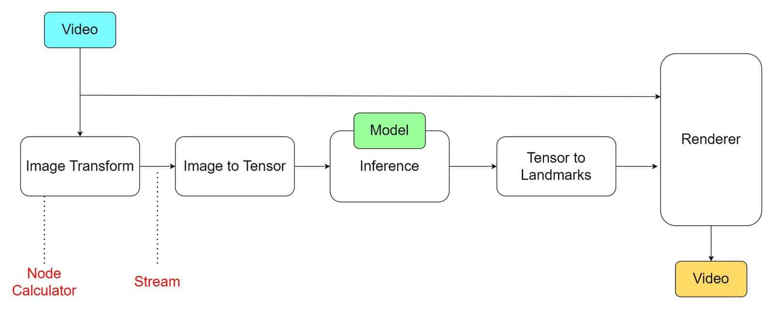
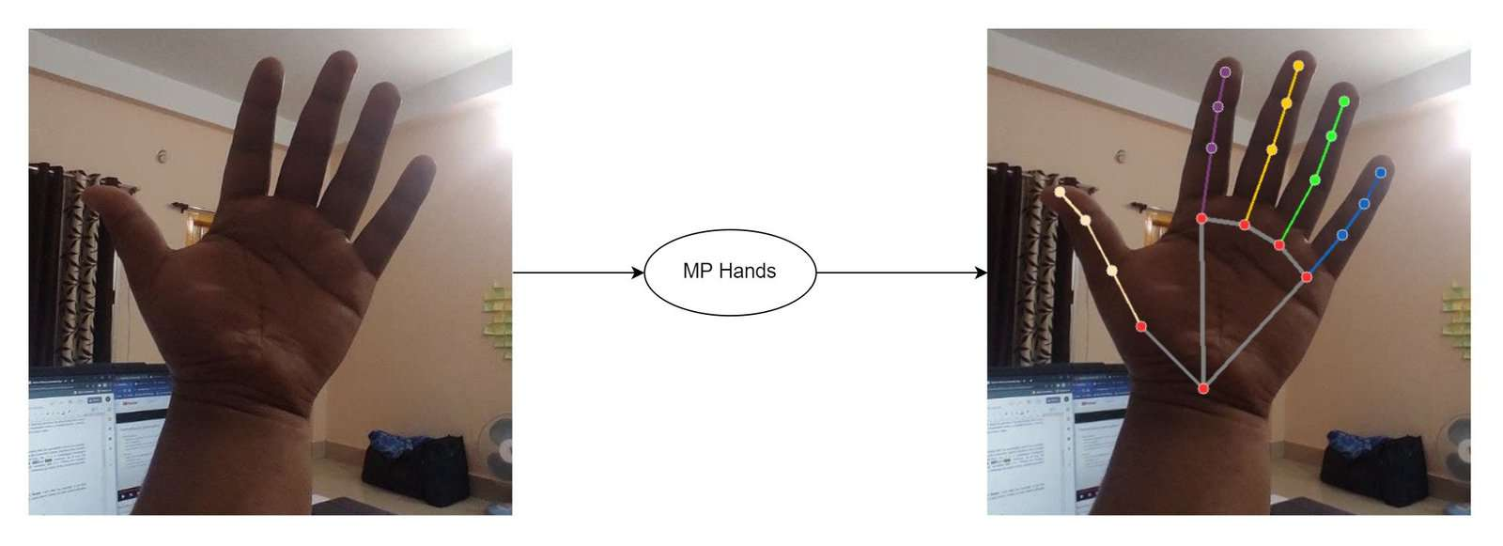
Mediapipe
Working of Mediapipe
Example of Mediapipe

Slide 14
OpenCV
Computer vision is a process by which we can understand the images and videos how they are stored and how we can manipulate and retrieve data from them.
OpenCV is the huge open-source library for the computer vision, machine learning, and image processing and now it plays a major role in real-time operation . By using it, one can process images and videos to identify objects, faces, or even handwriting of a human.

Slide 15
What is framework?
A framework is a structure that you can build software on. It serves as a foundation, so you're not starting entirely from scratch.

Slide 16

Streamlit Framework
Streamlit is an open-source Python library that makes it easy to create and share beautiful, custom web apps for machine learning and data science. In just a few minutes you can build and deploy powerful data apps.

Slide 17
Design of Web Application
Title of the Application
Start Button
Text Area
Text Area

Slide 18
Future Work
Coming for future upgradation :
We can work more on frontend part.
We can include sentiment analysis of reviews for selected movies.
We can include searching based on genres, popularity etc.

Slide 19
Part-3 Biblography

Slide 20
Tools & Technology
Frontend : Streamlit
Backend : Python
IDE’s : Visual Studio Code & PyCharm

Slide 21

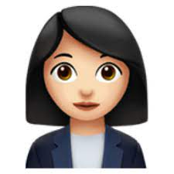

Thank You
Payal Verma
Krishna Chaudhary

